Slide 1

Bank Marketing Analysis

Slide 2
Direct Marketing in Banking Industry
Direct marketing provides a direct and measurable connection with target audiences.
It's a cost-effective compared to media advertising , mass appealing etc.
Direct marketing is a popular and effective tool, especially for smaller budgets. However, it lacks the brand image enhancement that comes with third-party accreditation.
Examples of direct marketing in Banking Sector
Santander Bank:
Leveraged a copy-oriented direct mail piece with a substantial sign-up bonus to encourage customers to open accounts.
Webster Bank:
Adopted a multichannel marketing approach, including direct mail, to announce their new mobile website, emphasizing enhanced customer convenience.
These examples showcase the adaptability and success of direct marketing in the banking sector, emphasizing its role in engaging and attracting customers through targeted strategies.
Notes:
Direct Marketing
- Its effectiveness is easily measurable, allowing for direct analysis and strategy adjustments. The challenge lies in profile-raising without external validation.
- It is appealing for budget-conscious companies. While lacking the image-building benefits of third-party accreditation, its effectiveness is easier to measure.
Advantages and Disadvantages :
- Its effectiveness is easily measurable, allowing for direct analysis and strategy adjustments. The challenge lies in profile-raising without external validation.

Slide 3
Introduction
Data
Conducted by a Portuguese bank, the dataset captures direct marketing campaigns.
Illuminates client behavior for targeted and effective banking marketing strategies.
Objective – Which occupation have a higher tendency to subscribe? By , answering this question, we want to achieve the following :
Identify High-Potential Markets
Optimize Resource Allocation
Build Long-Term Relationships
Our ultimate objective is to gather more and more clients by direct marketing
Notes:
Identify High-Potential Markets: Do some occupations have a higher tendency to say yes compared to other?
Optimize Resource Allocation: Each occupation with a higher tendency to say yes deserves to be spent more time by the marketing team for higher sales.
Build Long-Term Relationships: Prioritize building long-term relationships with clients from occupations with higher subscription tendencies. A focus on customer retention can lead to repeat business and positive word-of-mouth referrals.

Slide 4
Dataset Information
Output variable – Has the client subscribed to term deposit (binary: ‘yes’ or ‘no’)
Different independent variables include Job, Marital, Education, Average yearly balance, Housing or personal loan?
Data period: May 2008 – November 2010
Rows – 11162, Columns – 17
No missing values
Notes:
A Term deposit is a deposit that a bank or a financial institution offers with a fixed rate (often better than just opening deposit account) in which your money will be returned at a specific maturity time.

Slide 5
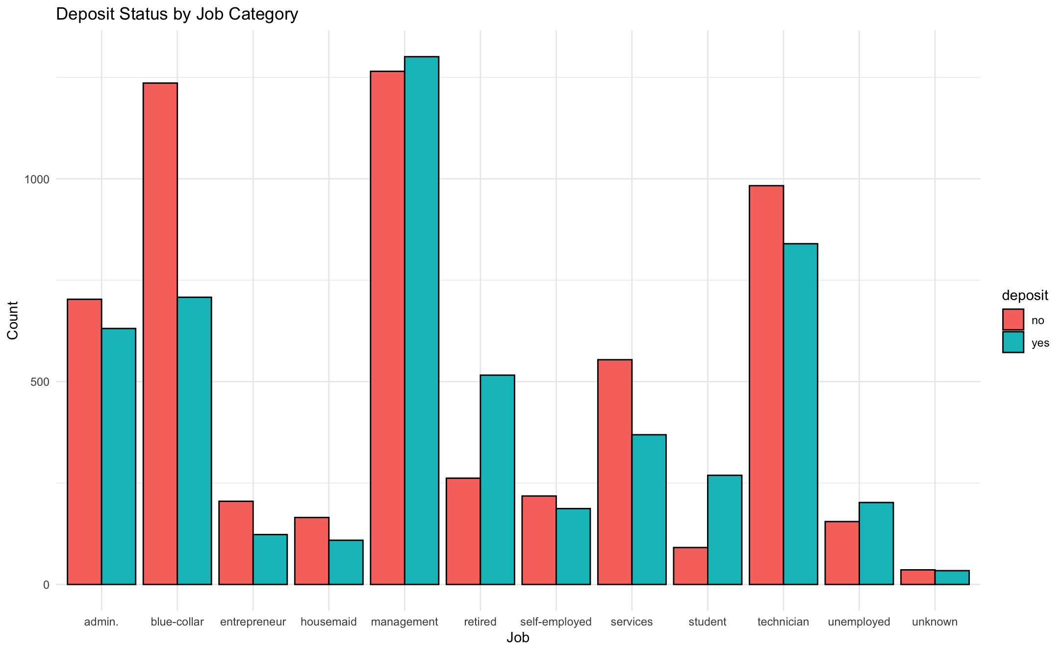
EDA
Notes:
Management have the highest success rate for deposits.

Slide 6
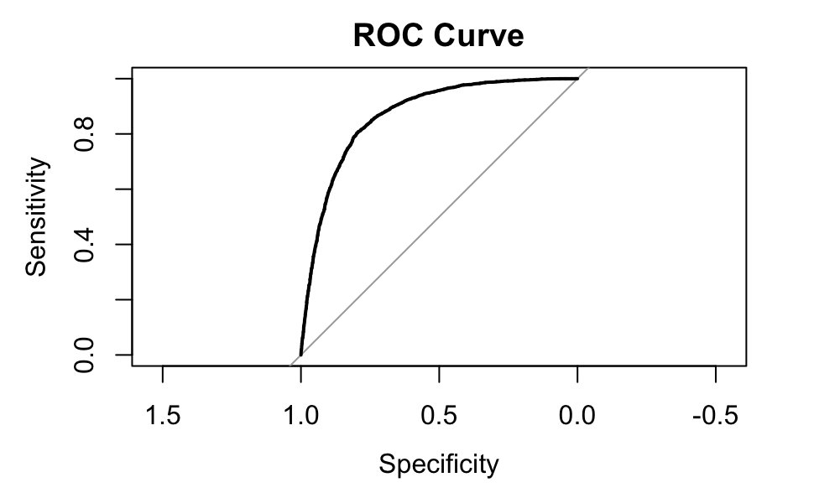
Model Selection
Logistic Regression handles binary outcomes effectively.
Balances simplicity and performance.
AUC-ROC score is 0.86.
Notes:
AUC-ROC score of 0.86 is indicative of a model with good discriminatory power between the Yes/No in the Term deposit variable.

Slide 7
Results
Occupation Analysis - Subscription Tendency
Management Field Leads: Individuals in management roles demonstrate the highest likelihood to subscribe to term deposits.
However, to summarize
Management professionals exhibit positive coefficients, next our Technicians and Students.
Develop Targeted Marketing Strategies for Each Segment.
Resource allocation and training to marketing teams on this information would increase sales.
Building Long-Term Relationships: Trust-building, tech-savy solutions and finanical planning with banking options
Notes:
Marketing Strategies :
Management Highlight investment opportunities, long-term financial planning, and premium banking services.
Technicians: Emphasize practical financial solutions, technology-friendly banking services, and career development-related products.
Students: Target with beginner-friendly services, student loans, and educational savings plans.

Slide 8
Conclusion
Through our analysis, we've uncovered valuable insights into subscription tendencies among different occupations.
The identified occupation segments, especially the management field, provide a clear focus for targeted and effective direct marketing campaigns.
Our aim is to use data analytics to continuously refine the approach based on the response rates and feedback from these target groups.
However, we would like to conclude by saying that direct marketing has been proved to be effective in this industry and it gives us a clear picture on how to achieve our goal better in our dataset.

Slide 9




THANK YOU

